Slide 1
Chalmers – for a sustainable future
Fredrik Hedenus
Associate professor, Senior Researcher
Division of Physical Resource Theory,
Department of Space, Earth and the Environment

Slide 2
Definition of sustainable development
Sustainable development is development that meets the needs of the present generation without compromising the ability of future generations to meet their own needs. (WCED 1987)

Slide 3
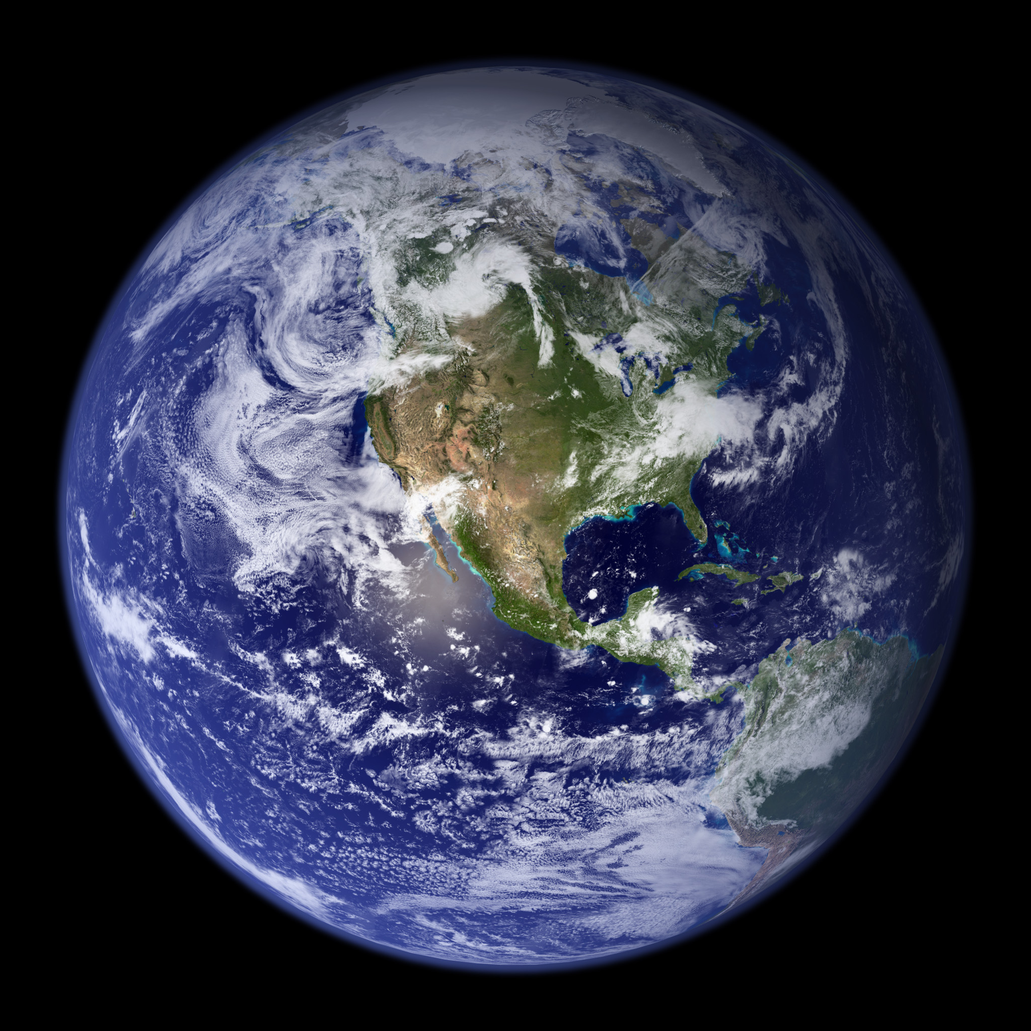
How can 10 billion people live a decent life on earth today and in the future?

Slide 4
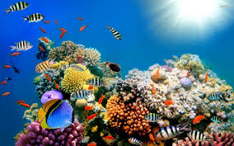
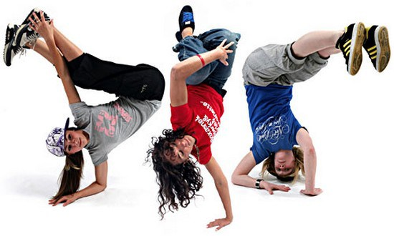
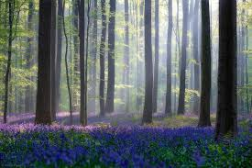
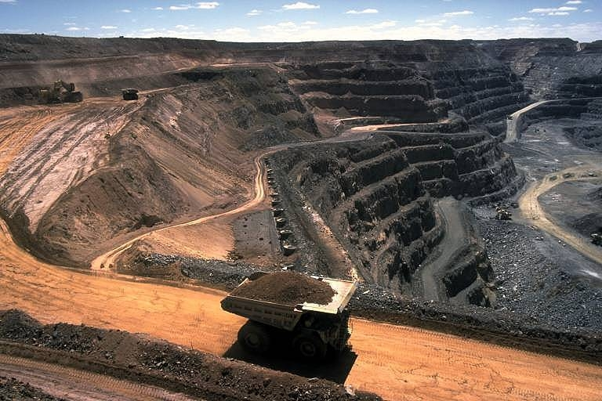
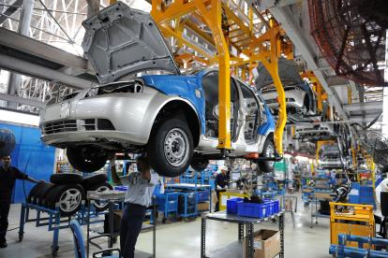
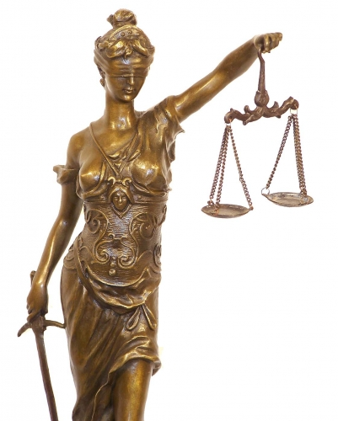

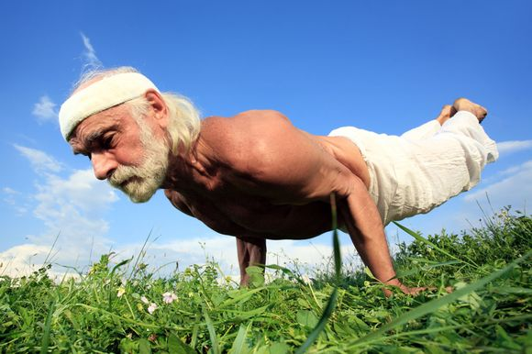
Sustain
Develop

Slide 5
What constitutes a sustainability issue?
(Mainly) future generations
Climate change
SUSTAINABLE DEVELOPMENT
(Mainly) wants
(Mainly) basic needs
Famine
Entertainment app
(Mainly) current generation

Slide 6
The three dimensions of sustainable development
NEEDS
ECOLOGICAL
ECONOMIC
SOCIAL
TIME

Slide 7
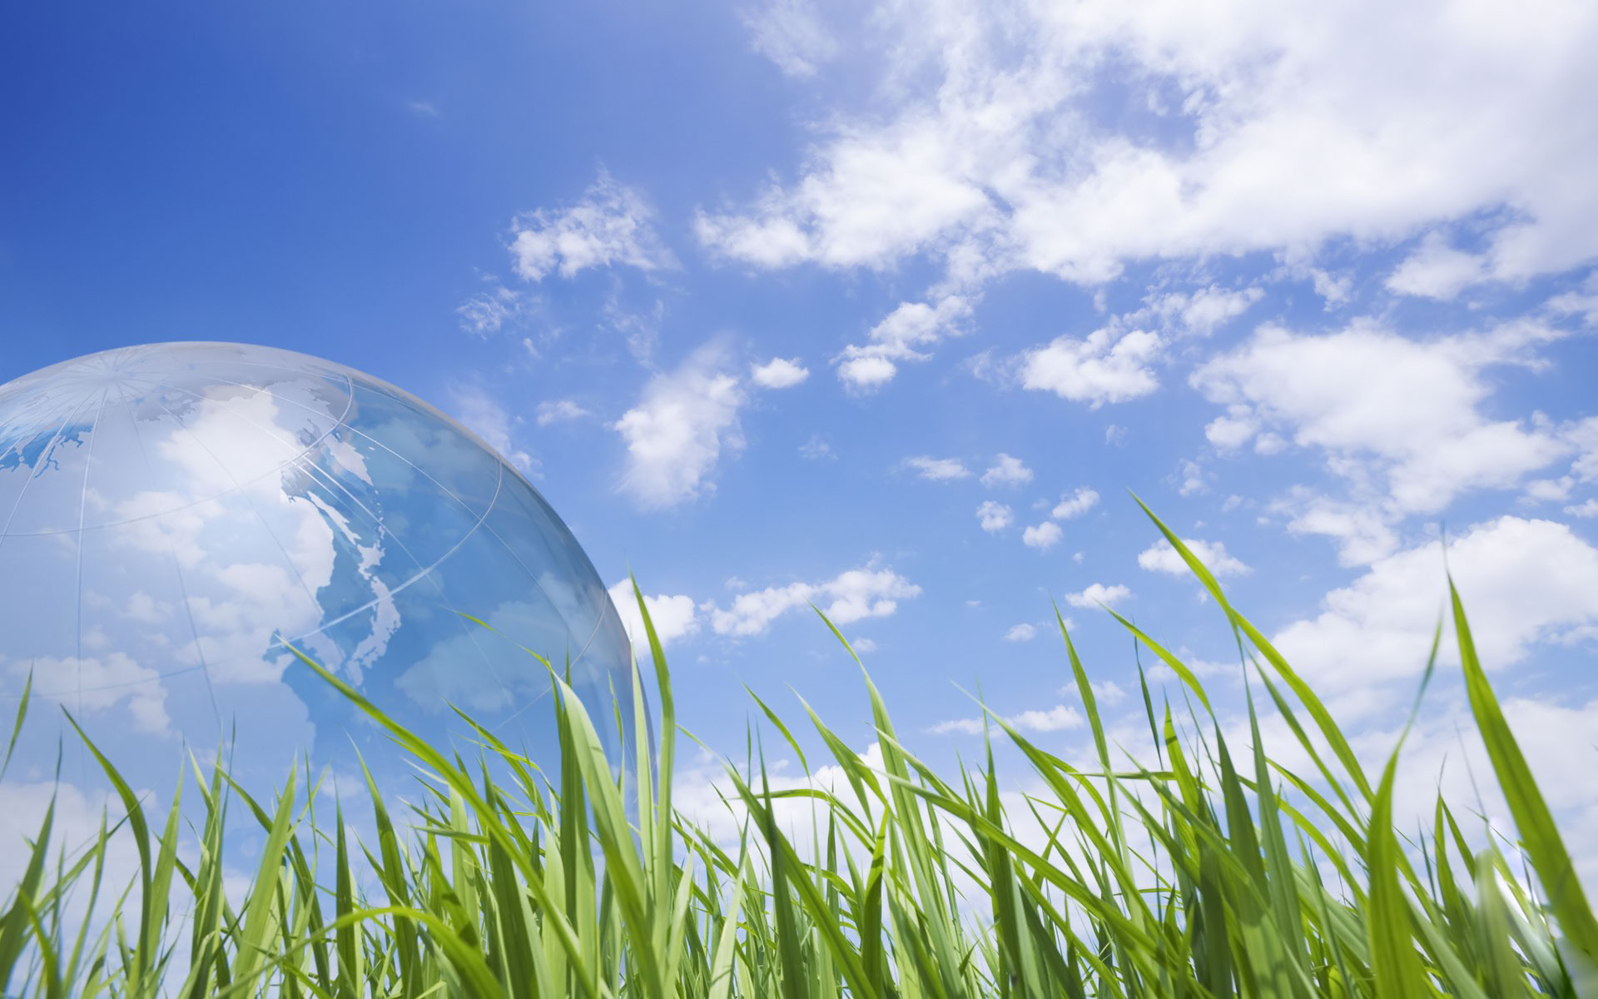
Ecological dimension
Preserving a living environment that is necessary to sustain a human population
  Production capacity
    Agricultural land
    Ecosystem services
    Hydrological cycles
  Assimilation capacity
    Acidification
    Carbon dioxide

Slide 8
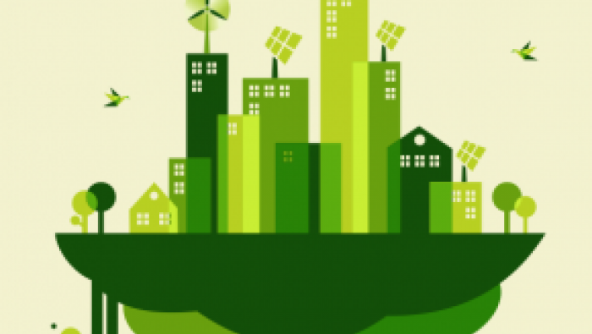
Economic dimension
Efficient use and allocation of resources
Extraction of non-renewable resources
  Metals, fossil fuels, phosphorous
Capital Stock
  Maintain and develop monetary capital

Slide 9

Social dimensionen
Social institutions that help human needs to be fulfilled.
  Distribution and control of power
  Create and sustain trust
  Efficient and capable institutions
  Guarantee human rights

Slide 10
How can an university contribute to a sustainable future?
Discuss with your neighbor

Slide 11
Knowledge production for present and future generations
To keep and manage knowledge for future generations
Develop technologies that address important needs today and in the future
Assess technologies. Where are the risks, how can they be alleviated?
Participate in societal debates and provide knowledge based perspectives.

Slide 12
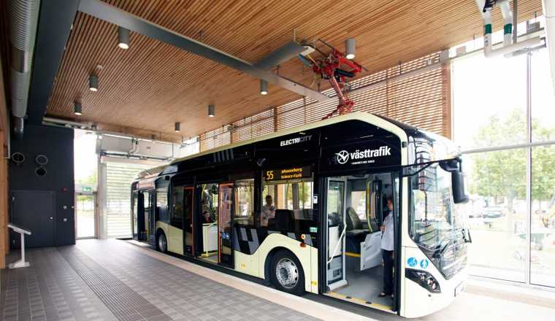
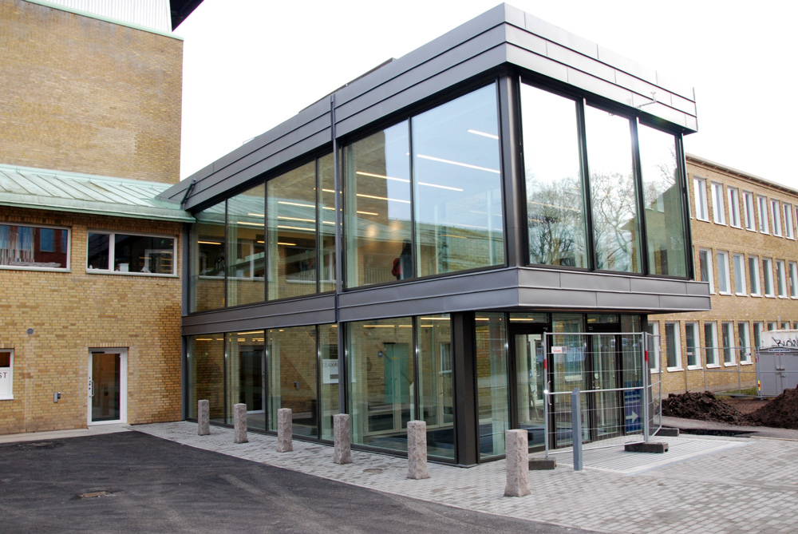
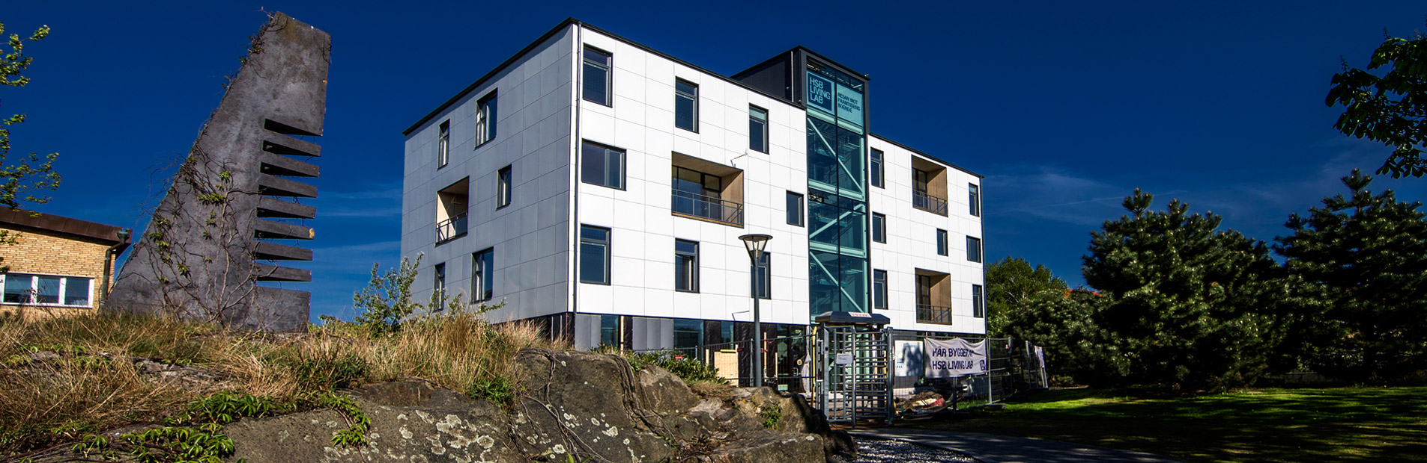
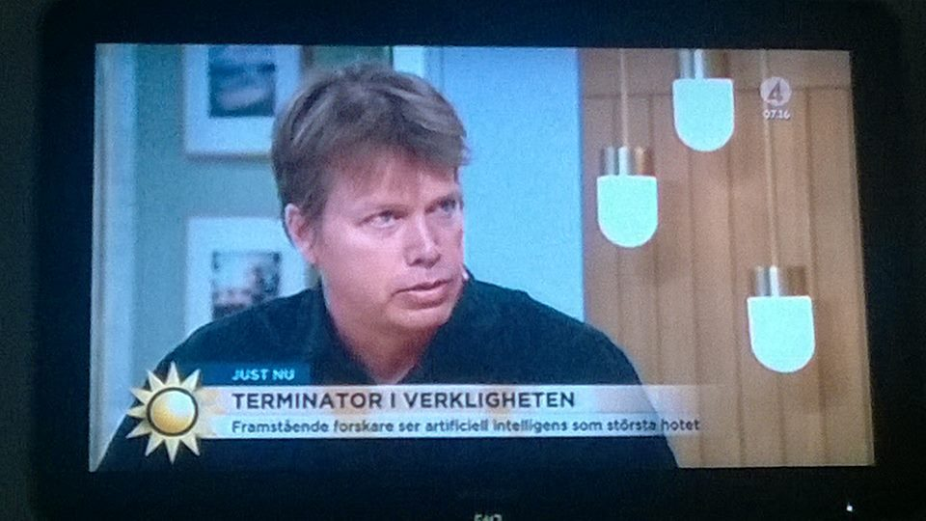
What is Chalmers doing?

Slide 13
But does sustainability have to do with your research?
That we will discuss and reflect on in the course: Sustainable development: Ethics, technology, society and the researcher

