Slide 1
Generic and transferable skills
Personal and Professional development
for PhD students
Catharina Hiort
Notes:
To all of you – warmly welcome to Chalmers!! Bla bla bla
My name is Catharina Hiort, and I am here in my role as acting head of the Generic and Transferable Skills program – or GTS – to tell you a bit about our activities… or enough for you to know what it is about and how you can find more information yourselves.
The scope of GTS is 15 credits and is an integrated part in your doctoral studies and you will have to take courses throughout your years here.
I would like to start by saying that we are three people in the team: myself and the coordinators: Anna and Malena co-ordinate courses to some 1,000 graduate students. which means offering 75 course-starts to more than 2,000 (2,016) participants per year.
So please remember: Congestion and waiting lists are sometimes unavoidable. PLEASE, remember that they are doing their very best to provide you with a really good and interesting program.
Lic:ar behöver inte göra en populärvetenskaplig presentation. Rekommendationen är att ska den göras efter lic.

Slide 2
WHY and how
Increasing expectations on universities from society regarding contributions to not only education and research, but also utilisation. For a sustainable future.
Chalmers PhDs are expected to become future leaders and change agents.
Networking and communication cross disciplines are important tools in change and development.
Having professional competences dramatically increases employability.
Government funding to Chalmers Areas of Advance
GTS is aligned with the European Commission’s Doctoral Training Principles.
Notes:
GTS started in 2011. It’s a quite unique initiative and an offer to all PhD students as a one-stop-shop for useful Interdisciplinary academic and professional competences. Most other universities typically offer a subset of these but not in the form of a centrally coordinated program.
The GTS program was initiated as a response to several triggers and possibilities.
Changing expectations on Chalmers from society regarding contributions to not only education and research, but also utilisation.
Around that time, the Swedish government had recently published the latest research bill called “A boost for research and innovation” (Ett lyft för forskning och innovation) in which they prompted the Swedish universities to apply for strategic funding for building up large initiatives for research and innovation. Chalmers applied, was extremely successful, and received large (not to say huge) strategic grants from the government. This became Chalmers Areas of Advance (that our vice president for research and doctoral studies, Anders, talked about…?). It was also decided that Chalmers would develop a program that would strengthen the training of doctoral students in Interdisciplinary academic and professional competences. GTS…
This of course made sense in many different ways…:
PhDs are expected to become future leaders and change agents. Particularly so with PhDs from Chalmers who have a strong tradition in populating many of Sweden’s top positions.
Increasingly important to work interdisciplinary to solve real-life challenges so networking cross-disciplines is important.
Also important to involve and communicate with non-experts (politicians, the general public, etc.) since no change will come about without their approval.
We know from very compelling statistics and from extensive dialogue with leaders in companies and other organisations in Sweden that having generic skills such as these dramatically increase employability.
And last but not least…:
These transferable skills are pointed out as essential in the European Commission’s Doctoral Training Principles.

Slide 3
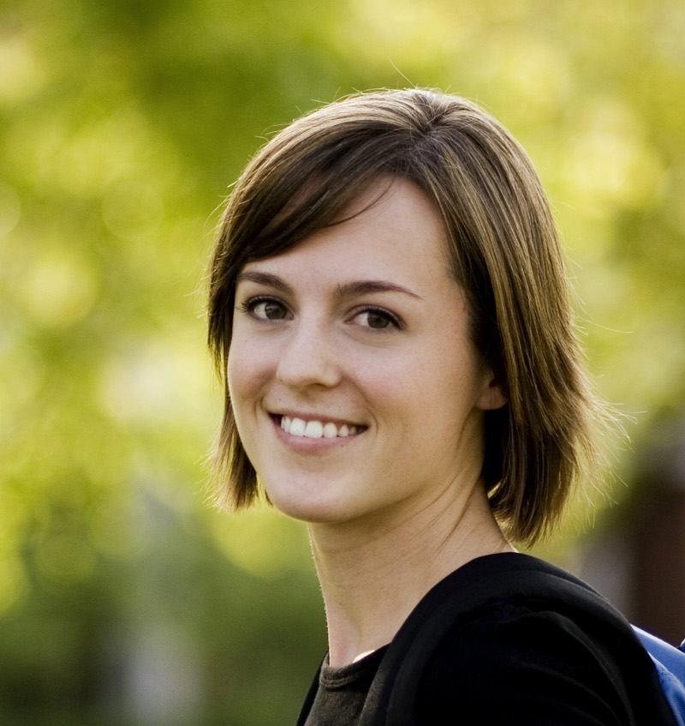
The aim of GTS
… provide education, training and coaching to support you in your ambition and towards your goals.
… prepare for a future career – academic and/or non-academic.

Slide 4
PROGRAM structure
List of
15 courses
(22,5 HEC)
3 mandatory courses (7,5 HEC)
12 elective courses (15 HEC)
2 mandatory activities (0 HEC)
15 credits from GTS is required for a PhD degree; 9 credits for a licentiate degree.

Slide 5
THE COURSES
Mandatory courses
Responsible research
  From research to policy for sustainable development
  Research ethics in science and technology (paused 2020)
  Sustainable development (3.0 HEC)
Scientific communication
  Introduction to writing for publication
  Academic writing
  Advanced communication – popular presentations
  Scholarly information retrieval
  Writing up for publication: concentrated academic-writing retreat

Slide 6
THE COURSES
Mandatory courses
Teaching and leadership
  Applied project management
  Career planning – your personal leadership (1.5 HEC)
  Creating and managing effective teams
  People in flow – personal effectiveness
  Reflecting on leadership perspectives and contexts
  Research utilisation
  Teaching, Learning & Evaluation (3.0 HEC)

Slide 7
THE Mandatory activities
√
Introduction
Popular Science Presentation

Slide 8
https://intranet.chalmers.se/en
SEARCH: GTS
About GTS
Courses (including sign-up)
Other important information
SEARCH: Competence development
Competence development for employees (leaders, managers, teachers, PhD students) at Chalmers

Slide 9

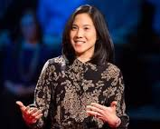
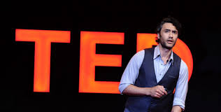
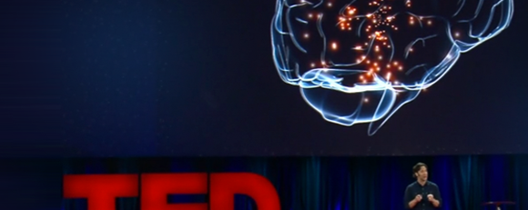
Popular Science Presentation oral and written
Notes:
I probably don’t have to tell you that it’s an important task for any scientist – to disseminate ones findings… and to present what you are currently working on or have done. Of course you do this witin your scientific community by publishing different types of publication (I believe Jessica is going to tell you more about pulishing, but I would like to remind you that GTS has a couple of very good courses in which you learn to write scientific texts),
Apart from the scientific publishing, you will also need to disseminate your research at a number of other occassions, for example:
To make yourself visible for future employers and collaborators
In many job interviews
When you want to share findings with the general public, for example in a radio interview
When you have received the Nobel Prize and get to sit and speculate on TV with the other geniuses
For some applications for funding or when involved in fundraising
When teaching students – particularly in the first years
In explaining your area of expertise to prepare for interdisciplinary teamwork with non-experts in your field
At a dinner party where you would like to stun your fellow party-goers with your awesome elevator pitch
Or simply when your dad asks (for the 50th time) what it is that you research and if you have actually discovered anything.
In this activity you will learn that its all about preparation… and practice… and getting feedback from friendly colleagues.
And I would like you to remember when it’s time for you to do it (we recommend you do it AFTER your licentiate) that it is important that you do it in a challenging setting, where the audience is truly non-experts, for example at the big science festival that is held in Gbg each spring, or at your old elementary or high school.
We are currently looking at developing different new platforms: podcasts, video blogs, powerpoint presentations with voice over, etc.
NB! Support offered: Advanced communication course where you discuss and practice your presentation skills in a workshop setting.
The written popular science presentation is part of your thesis work and is used to inform the public about your research. It will for example be used for identifying material for press releases by Chalmers communication and marketing department.

Slide 10
Popular Science Presentation
Recommendation:
AFTER licentiate.
Look at the instructions on the GTS website
(Take the Advanced Communication course)
Find a platform/setting for your presentation
Prepare, practice, get feedback
Present your research before an audience of lay people
Get written feedback (use the form)
Write and submit a reflection… examination!
A library, a high school, a club, an association, a group of friends, the Intl. Science Festival (Gothenburg), a podcast, a youtube video, etc.
Notes:
Lic:ar behöver inte göra en populärvetenskaplig presentation. Rekommendationen är att ska den göras efter lic.

Slide 11
Registration in Ladok
Not formally registered as a PhD student in Ladok = No credit for the General Introduction Day UNTIL you are registered.
Registration in Ladok is a process! Can take up to 2 months
Notes:
HOW many of you are already registered in Ladok? If not – contact your own department’s student administrator. Your supervisor knows who it is if you don’t.
Ladok is the Swedish national IT-system for registration of university students and their study results.
”It is important you sign the participant list available at the venue, since attendance is compulsory for all Chalmers PhD students and to ensure your attendance is registered.
Please note that if you attend the course prior to being formally admitted as a PhD in Ladok the GTS student administrator cannot register your attendance. It is then your responsibility to notify the GTS team as soon as you are admitted as a PhD, so that your attendance can be registered in arrears yet as soon as possible after your attendance. If unsure whether you are admitted in Ladok or not yet, please check with in first instance.”

Slide 12
What we expect of You
Register in Ladok.
Talk to your supervisor(s) and plan for your course work.
Register for courses and activities (GTS on the intranet).
Your attendance and active participation in all parts of a course.
Your constructive feedback after completion of a course.
Give notice well ahead of time if you need to cancel your participation: in the booking system, at least 1 week prior to the course start. Late cancellation fees will be charged to your division.
Notes:
If you cancel later than 1 week prior to the course start, your department will be fined 1,000 SEK. If you fail to show up without cancelling your participation, your department will be fined 1,500 SEK.
The slots are expensive… very hard for people to get in on a course with only a few days of notice… so help the system and cancel in good time.

Slide 13
Tips from the coach…
PLAN & SAVE
ASK
SHOW UP or CANCEL
BE ON TIME
BE ACTIVE & CONTRIBUTE
NETWORK & SOCIALISE
ENJOY
PASBBNE!
Notes:
Since you have to sign up for courses months in advance… be sure to save the dates in your calender.
If you don’t know – get in touch.
Everyone Chalmers loves a good acronym!!

Slide 14
Come to us with your questions
genericskills@chalmers.se
Anna Stupak, Malena Gorgne and Catharina Hiort

